Slide 1
BCOG 100
Memory, Simulation, & Generative Models
Lecture 3: Memory & Simulation in the Brain

Slide 2
Reading Check 9-3
Password: cortex
Think about your oldest memory? Given what we’ve learned in this class so far, why do you think it is your first?

Slide 3
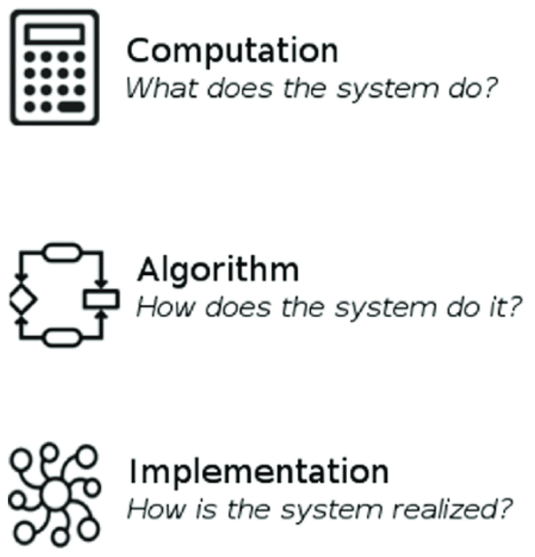
Memory and Simulation in the Brain
Recap & Overview
Last Time:
How prediction works.
Today:
Where it happens and how it is implemented.
Brains turn algorithms into anatomy.
Notes:
In Lecture 2, we saw how intelligence can be understood algorithmically—as a hierarchy of modeling power:
prediction, generation, and causation.
Today, we move to Marr’s third level: implementation—how those computations are physically realized in neural circuits.
Every algorithm must live somewhere, and in biology, that “somewhere” is the brain’s tissue.
Neurons, synapses, and networks form layered systems that make prediction possible in real time.
From the cortex to the hippocampus to the basal ganglia, we’ll trace how these structures embody the same loops we’ve already studied:
predict → compare → correct → update.
We’ll also see that evolution didn’t invent these systems from scratch—it reused and extended older architectures.
The mammalian brain is not a new machine; it’s an elaboration of an ancient predictive engine.

Slide 4
Memory and Simulation in the Brain
Prediction
Generation
Causation
The Brain as a Hierarchy of Predictors
Higher areas predict lower areas.
Lower areas report prediction error.
Perception is prediction passing the test.
Notes:
The brain isn’t a single predictor—it’s a hierarchy of them.
Each level of processing, from the sensory periphery to the prefrontal cortex, is both a student and a teacher:
it learns predictions from the layer above and sends its own predictions downward.
Higher regions generate expectations about what lower areas should perceive.
Lower areas compare those predictions with incoming sensory data and send back prediction errors when things don’t match.
That back-and-forth exchange continues up and down the system until prediction and evidence align.
In this view, perception is the moment when top-down expectations perfectly fit bottom-up input—when the model and the world agree.
It’s not data traveling upward—it’s hypotheses traveling downward, corrected by surprise.

Slide 5
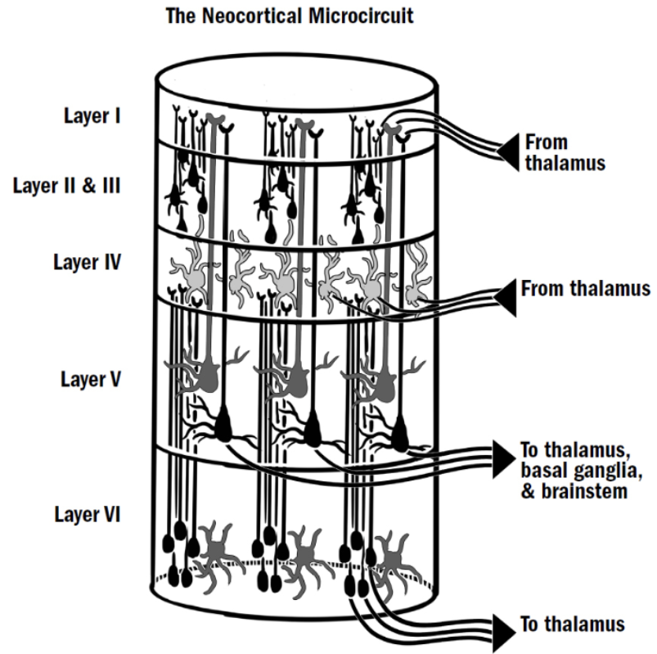
Memory and Simulation in the Brain
Cortical Architecture: Layers and Loops
The neocortex is a six-layer loop.
Feedforward signals carry data up.
Feedback signals carry predictions down.
Notes:
The cortex—especially the neocortex—is the physical substrate of prediction.
Across nearly all sensory and associative regions, its structure is remarkably uniform: a six-layer sheet of neurons, repeated millions of times across the brain’s surface.
This architecture supports two opposing flows of information.
Feedforward pathways—from lower to higher layers—carry sensory evidence upward.
Feedback pathways—from higher to lower layers—carry predictions downward.
When these meet, mismatches generate prediction errors, which travel back up the hierarchy to refine the model.
Each cortical column acts like a tiny prediction machine—sending hypotheses down, receiving error signals up, and adjusting until the two align.
This layered, recursive structure lets the cortex implement complex inferences using the same simple local rule repeated everywhere:
predict, compare, correct.

Slide 6
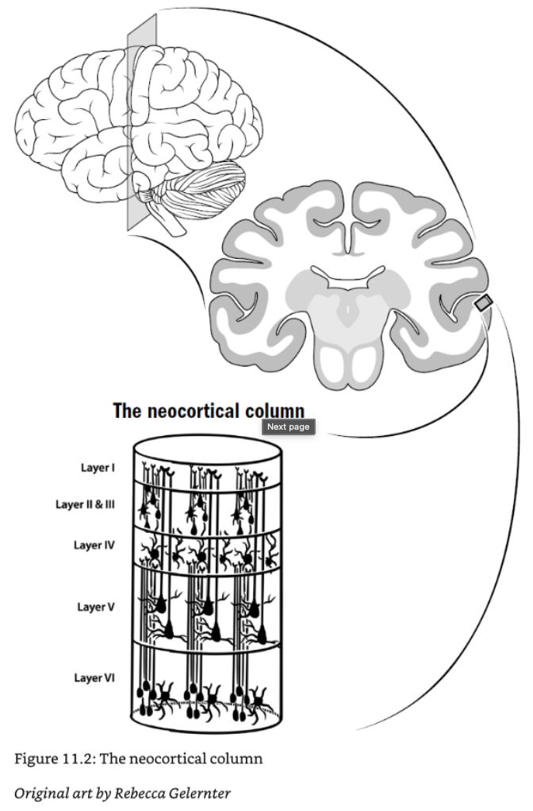
Memory and Simulation in the Brain
Cortical Columns as Mini-Predictors
Each column learns local regularities.
Together, they form a world model.
Prediction is built from many tiny guesses.
Notes:
The neocortex isn’t one big predictive system—it’s billions of small ones working in parallel.
Each cortical column, a vertical bundle of roughly 10,000 neurons, functions as a mini-predictor.
It receives a specific stream of input—like a patch of retina or a tone frequency—and learns the patterns that usually occur there.
Within the column, excitatory and inhibitory neurons form a loop that continuously tests its own expectations.
Incoming signals are compared against stored patterns, and the resulting error signal helps the column adjust.
Columns that process neighboring inputs share their results through lateral connections, allowing local predictions to merge into global ones.
The remarkable thing is that this same circuit exists everywhere—vision, hearing, touch, even language and planning.
Each column learns the regularities of its own “micro-world.”
The brain’s apparent unity comes from the collective coherence of these countless small models.
Evolution didn’t need a different circuit for every function—it just replicated a single predictive module and let learning specialize each copy.

Slide 7
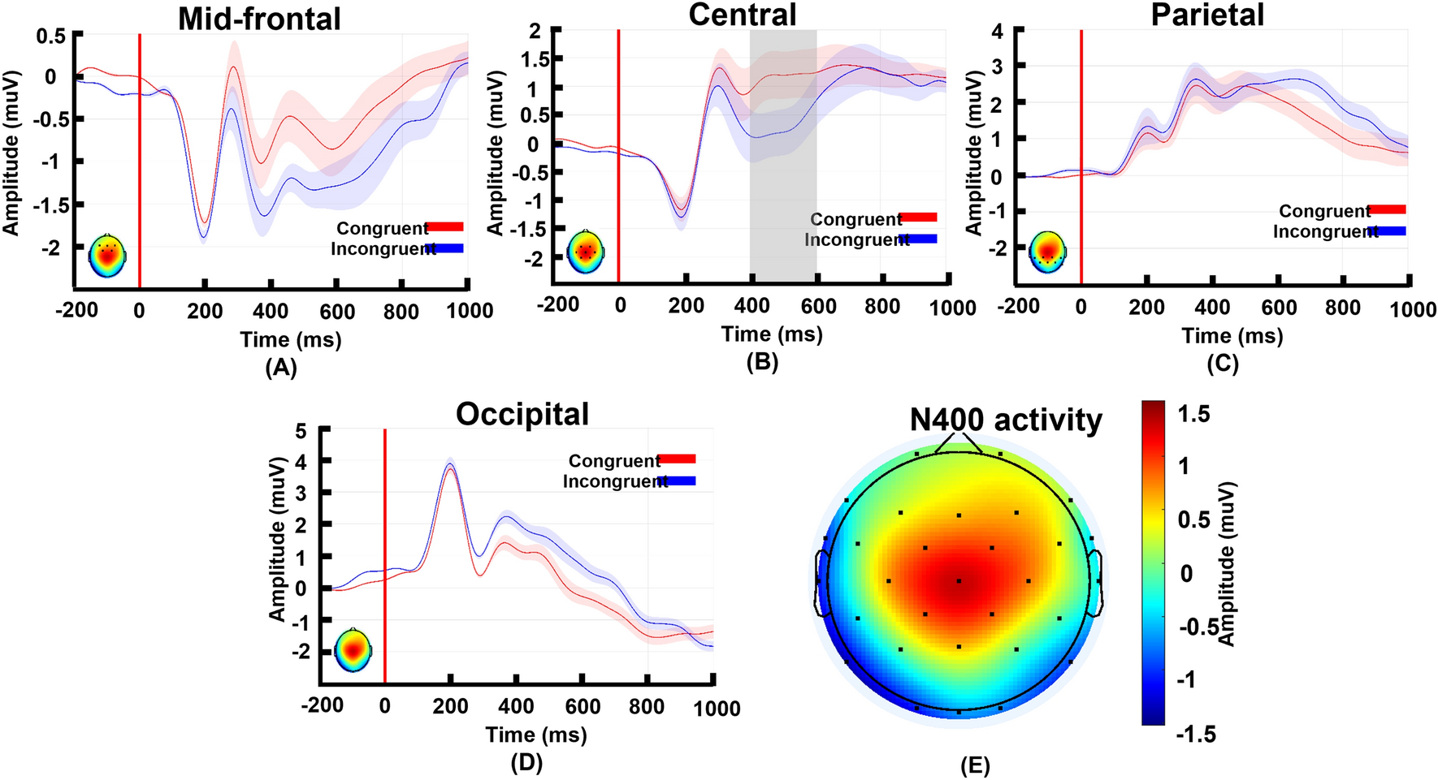
Memory and Simulation in the Brain
Prediction Error in Sensory Cortex
Sensory neurons fire when predictions fail.
Expectation dampens activity.
Surprise lights the brain up.
Notes:
If perception is prediction checked against input, then we should see this reflected in neural activity—and we do.
Across visual, auditory, and somatosensory cortex, neurons respond most strongly when the incoming signal violates expectations.
In the visual cortex, activity decreases for predictable stimuli
—like a repeated pattern—and spikes when something unexpected appears.
In the auditory cortex, a tone that breaks a learned sequence triggers a distinct “mismatch negativity” response,
even when the listener isn’t consciously attending.
In other words, neurons fire to error, not to confirmation.
The same mismatch responses appear in rodents, birds, and primates
—evidence that predictive coding is an ancient vertebrate mechanism for efficient perception.
This makes perception highly efficient: predictable inputs are explained away
—literally subtracted from neural firing—so that only surprise drives further processing.
The brain saves energy by silencing what it already knows.
Prediction errors are the spotlight of perception.

Slide 8
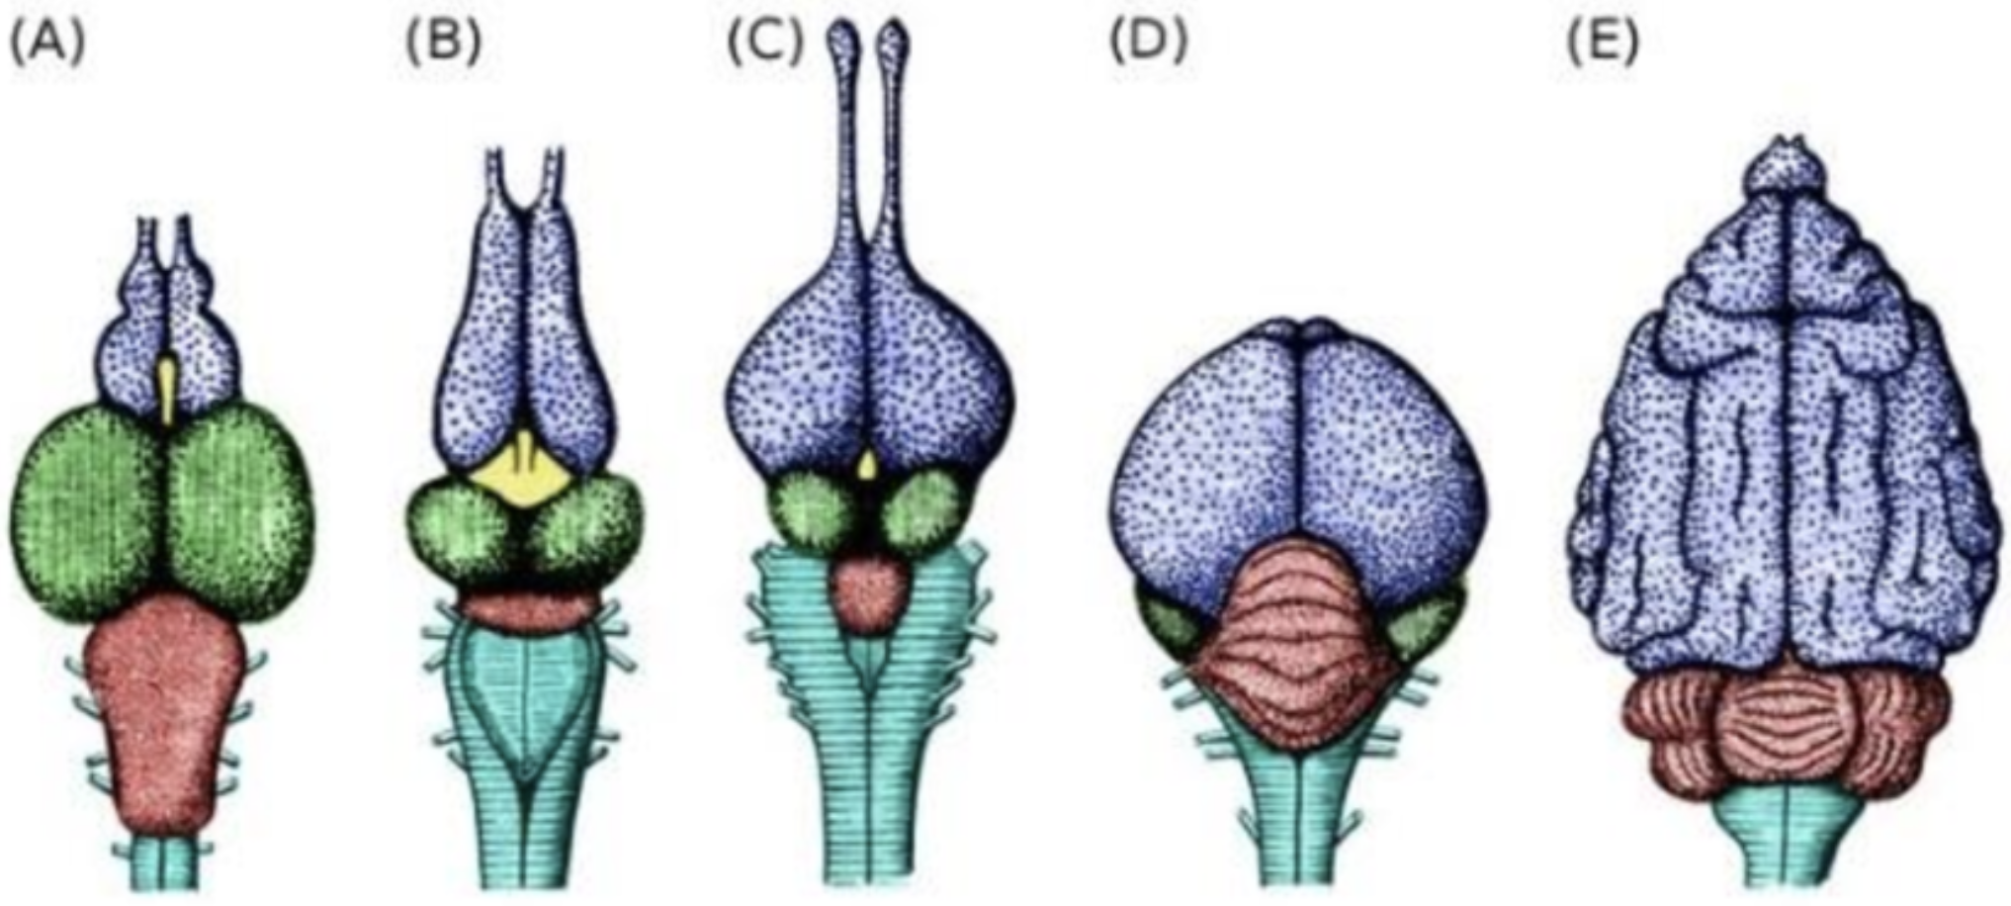
Memory and Simulation in the Brain
Fish
Frog
Snake
Dove
Dog
The Predictive Brain Across Species
Prediction is older than the cortex.
Different brains, same algorithm.
Evolution reuses the predictive loop.
Notes:
The predictive loop we’ve been describing—predict, compare, correct—is not unique to humans, or even to mammals.
Across vertebrates, we see versions of the same computation implemented in different architectures.
In fish and amphibians, subcortical circuits already anticipate sensory consequences of movement.
When a fish turns, it subtracts its own motor signal from the expected sensory input
—a primitive form of prediction error cancellation.
In birds, the pallium—the avian counterpart to the mammalian cortex
—has no six-layer structure, yet shows similar reciprocal connections and mismatch responses.
Corvids and parrots, in particular, demonstrate predictive coding in auditory and motor areas,
supporting complex vocal learning and planning
In mammals, the neocortex amplifies the same loop dramatically
—stacking multiple levels of prediction and abstraction.
But the core idea is ancient:
Brains evolved not just to react to the world, but to anticipate it.
Evolution kept reusing the same algorithm—just expanding its scale and complexity.
Prediction didn’t start in the neocortex—it’s the logic of life in motion.
The cortex simply scaled it up, turning anticipation into imagination.

Slide 9
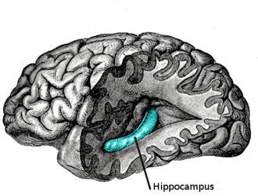
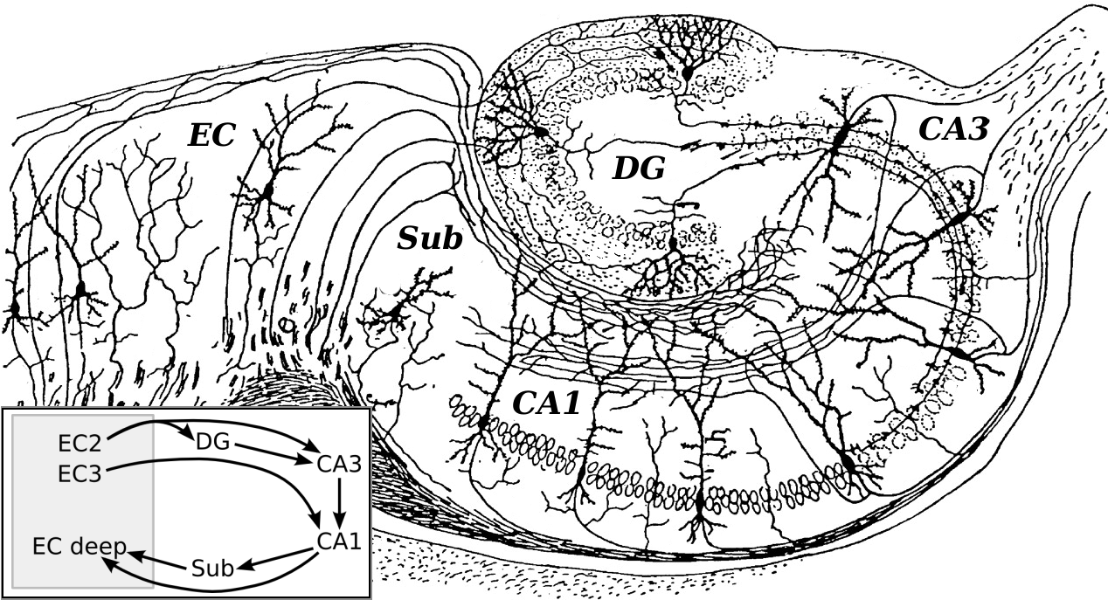
Memory and Simulation in the Brain
The Hippocampus: Mapping Space and Memory
The hippocampus builds maps of experience.
Place, grid, and head-direction cells simulate space.
From navigation to memory: the same code.
Notes:
The hippocampus is the brain’s simulation engine.
It builds internal maps of both physical and mental space—representations we can move through even when we’re not physically there.
In the 1970s, John O’Keefe discovered place cells—neurons that fire when an animal occupies a particular location.
Later, researchers found grid cells in the entorhinal cortex, forming a hexagonal coordinate system for tracking position.
Head-direction cells add a compass-like orientation signal.
Together, these systems let the brain build a dynamic map of the environment—a predictive model that simulates movement, predicts sensory input, and guides decisions.
But these cells don’t only code for space.
They also support episodic memory—the ability to replay and reconstruct past experiences.
In mammals, the hippocampus unifies navigation and memory because both require the same skill:
constructing an internal model of the world and our position within it.
In the hippocampus, we see prediction taking the form of spatial simulation.
But these same circuits replay and imagine sequences—making them the foundation of memory and imagination alike.

Slide 10
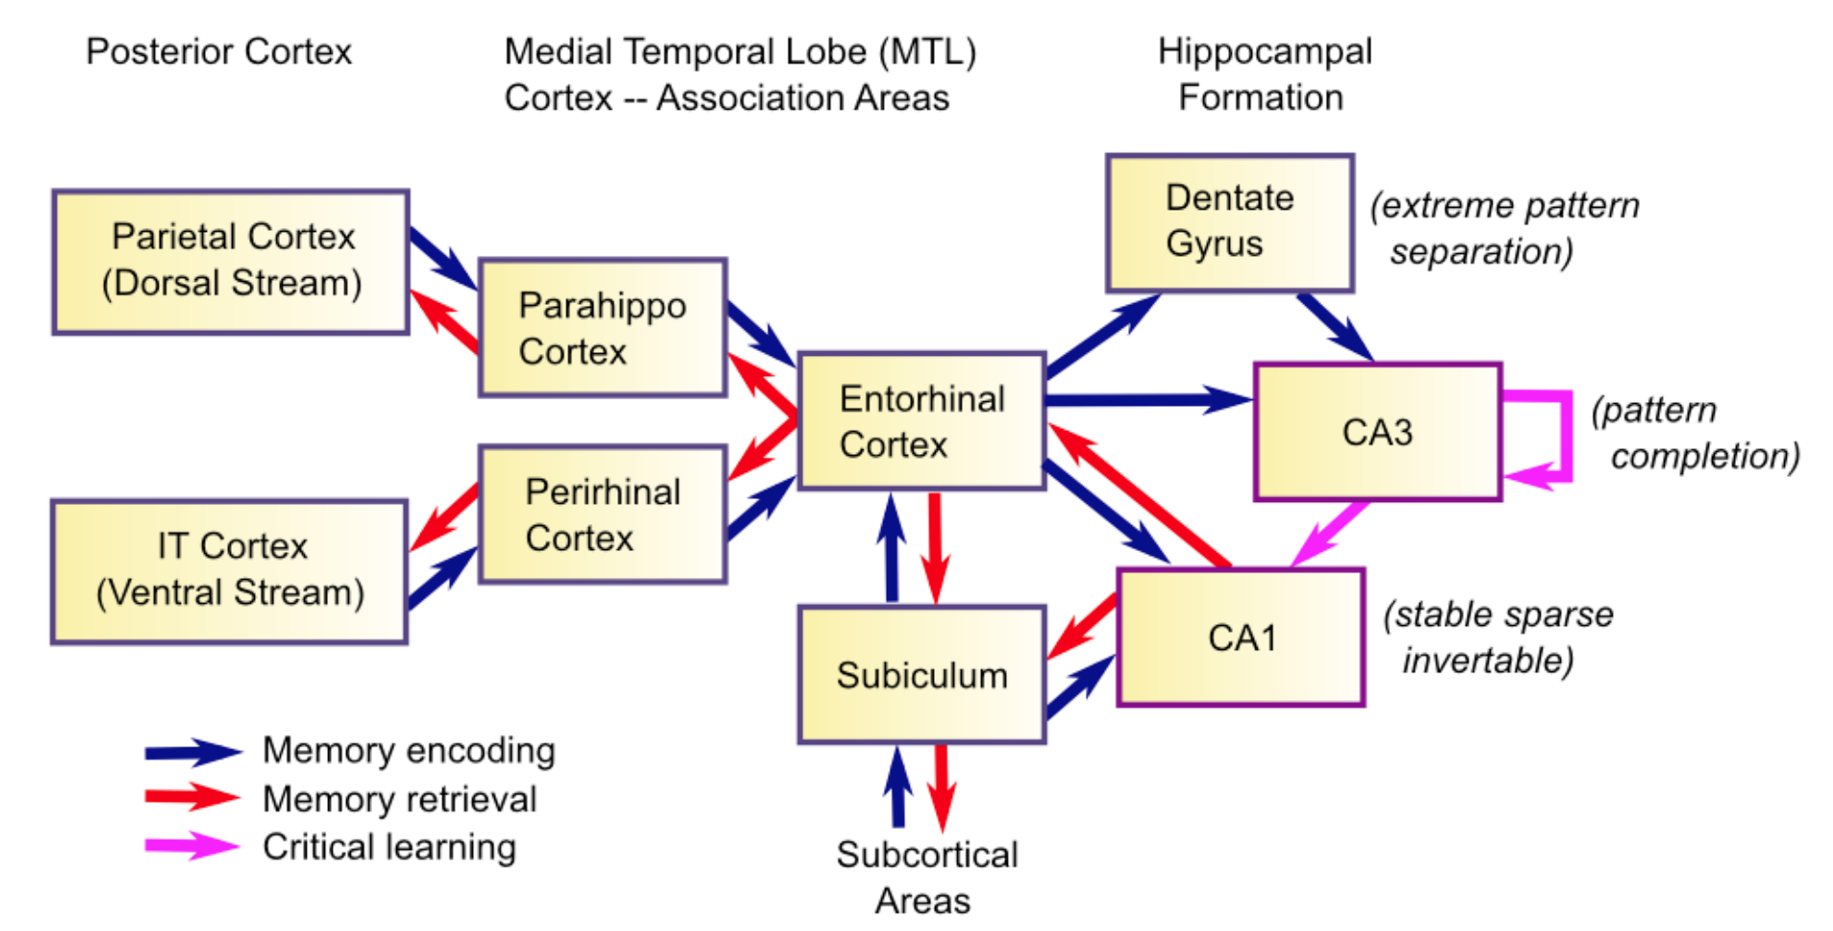
Memory and Simulation in the Brain
Binding “What” and “Where”: Entorhinal Inputs to the Hippocampus
The hippocampus builds maps of experience.
Place, grid, and head-direction cells simulate space.
From navigation to memory: the same code.
Notes:
The hippocampus doesn’t just map where we are—it connects that map to what is happening there.
It sits at the crossroads of two major input streams that converge in the entorhinal cortex, the brain’s gateway between the cortex and hippocampus.
From the temporal cortex, the hippocampus receives richly processed sensory and object information—the “what” of experience.
From the parietal and retrosplenial regions, it receives spatial and directional information—the “where.”
These converge in the lateral and medial entorhinal cortices (LEC and MEC), which send complementary signals into the hippocampus.
Inside the hippocampus—especially in the CA1 region—these streams merge into unified episodes:
“What happened, where it happened, and in what sequence.”
That integration is what allows you to remember not just seeing a red door, but which street it was on, and when you walked by it.
This binding of “what” and “where” is the essence of episodic memory and the bridge between perception and imagination.
This architecture explains why damage to the hippocampus causes amnesia for episodes but not for isolated facts or skills.
It’s the system that binds features into the story of experience.

Slide 11
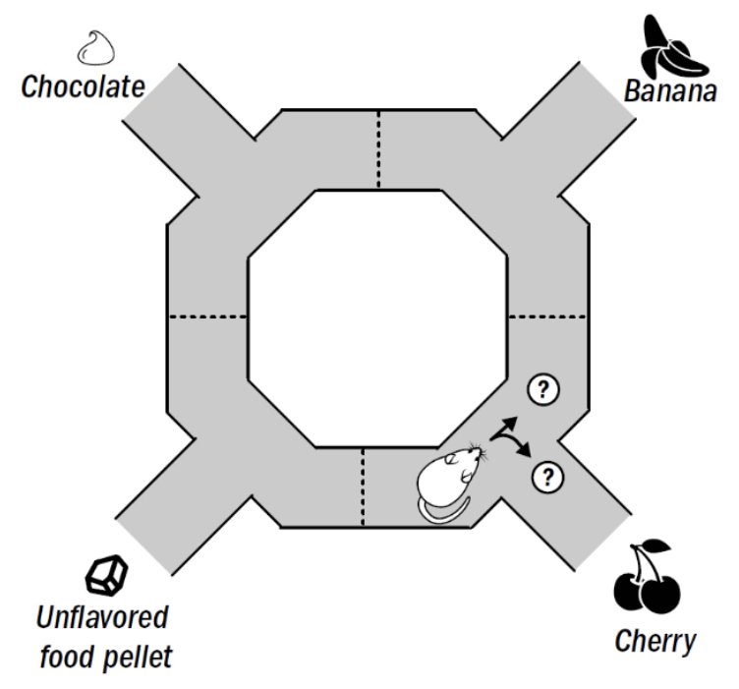
Memory and Simulation in the Brain
Replay and Preplay: The Neural Basis of Imagination
Hippocampal sequences replay the past—and preplay the future.
Simulation links memory to planning.
The same circuit encodes, rehearses, and predicts.
Notes:
When an animal explores, hippocampal place cells fire in sequence—A, then B, then C—as it moves.
During rest or sleep, those same neurons fire again in the same order, but faster.
That’s replay—the brain rehearsing experience to consolidate memory.
Sometimes, before moving, the hippocampus fires future sequences—simulations of possible paths.
That’s preplay, a kind of internal planning.
Replay integrates the past; preplay anticipates the future.
Both rely on the same predictive loop.
The hippocampus records, compresses, and reactivates experience, letting the animal imagine before it acts.

Slide 12
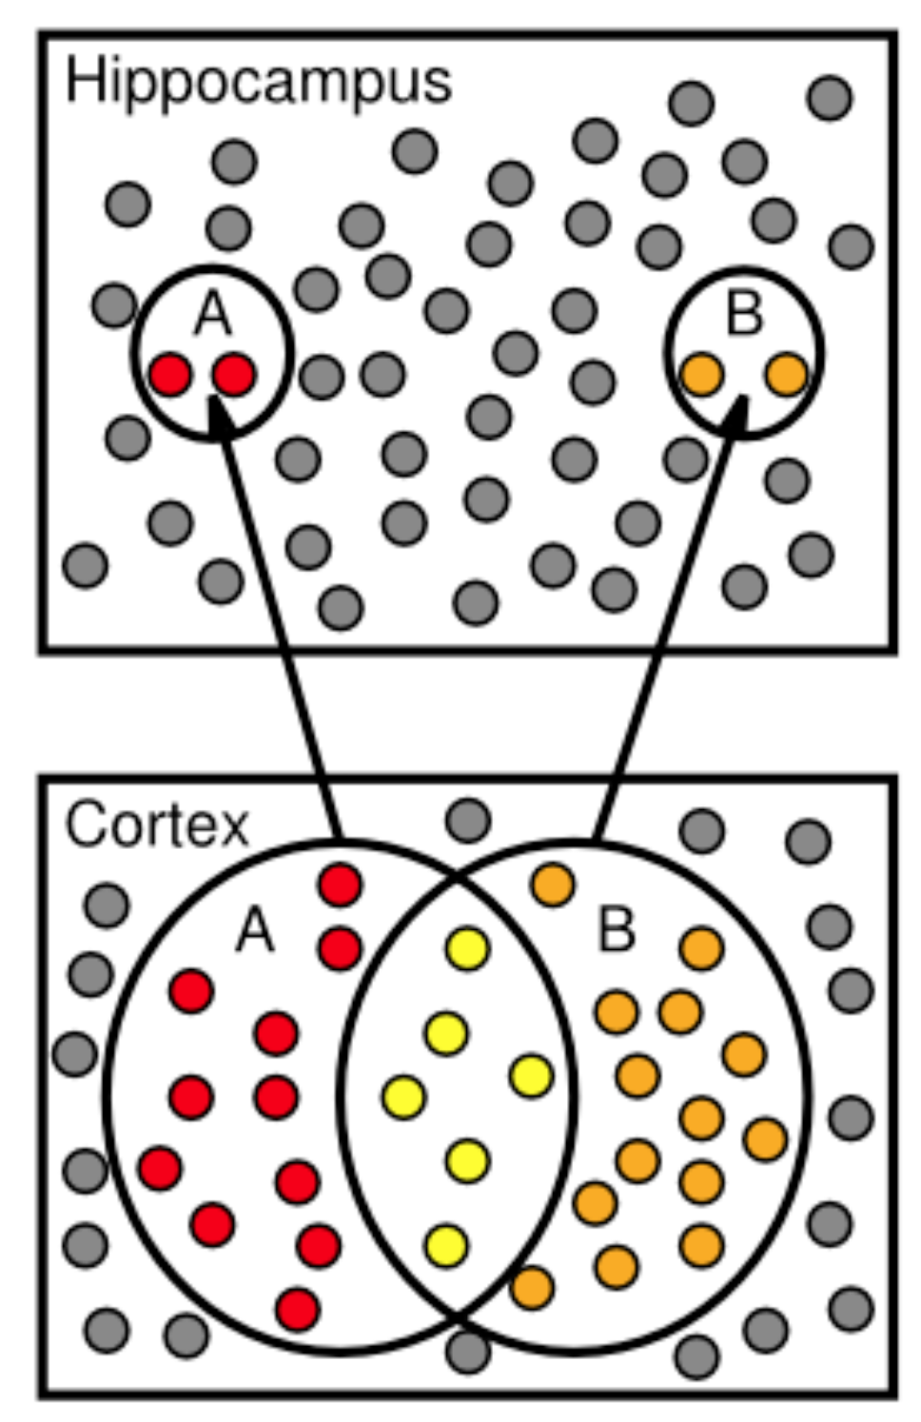
Memory and Simulation in the Brain
The Hippocampus–Cortex Dialogue: Memory Consolidation and Integration
Hippocampus stores new episodes fast.
Cortex learns slowly, through replay.
Memory is a conversation between the two.
Notes:
The hippocampus and cortex learn at different speeds.
The hippocampus captures events quickly, storing new episodes after a single experience.
The cortex learns slowly—averaging across many examples to extract general structure.
During sleep and rest, replay lets these systems talk.
Hippocampal sequences reactivate recent experiences, training cortical networks to integrate them.
Over time, the cortex absorbs what was once a unique event, turning memory into knowledge.
When the two fall out of sync—after hippocampal damage or sleep loss—new memories can’t form properly.
Consolidation depends on this ongoing dialogue:
hippocampus teaches, cortex generalizes.
The hippocampus gives the cortex its experiences; the cortex gives those experiences meaning.

Slide 13
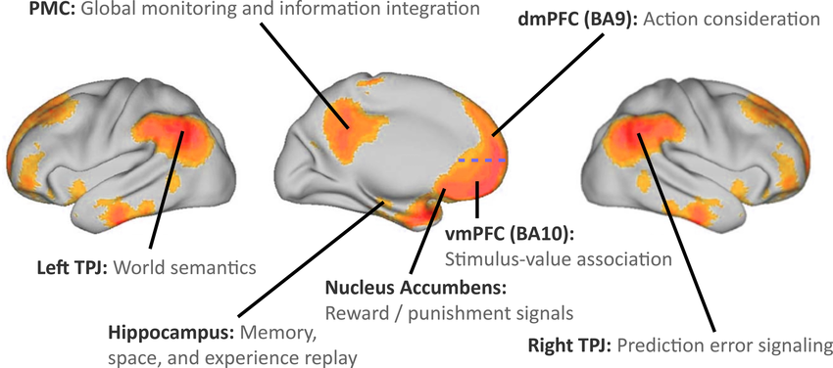
Memory and Simulation in the Brain
The Default-Mode Network: The Brain’s Simulation Space
When the brain is “at rest,” it’s not idle.
The default-mode network simulates worlds, selves, and times.
Imagination is the brain’s baseline.
Notes:
When we stop focusing on the outside world, another network takes over—the default-mode network, or DMN.
It links regions like the hippocampus, medial prefrontal cortex, and posterior cingulate.
Rather than processing input, it runs internal simulations.
The name “default mode” comes from early brain-imaging studies.
Researchers found that when people rested quietly in the scanner—between tasks or with eyes closed—this network stayed active by default.
So it’s not about sensory input being the default; it’s about the brain’s natural baseline activity turning inward.
The DMN lights up during daydreaming, remembering, planning, and imagining the future.
It weaves memories, goals, and possibilities into a continuous sense of self.
Far from idle time, this network keeps the brain’s internal model alive and ready for whatever comes next.
The default-mode network isn’t downtime—it’s the mind’s rehearsal space, constantly predicting, remembering, and imagining.

Slide 14
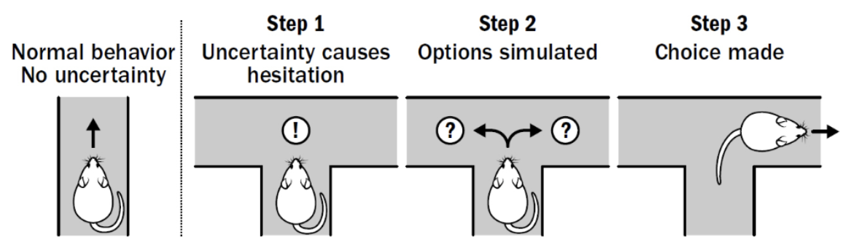
Memory and Simulation in the Brain
Prefrontal Cortex: Modeling Goals and Futures
The prefrontal cortex simulates actions before doing them.
It builds goals, plans, and counterfactuals.
Imagination becomes control.
Notes:
If the hippocampus lets us replay and preplay experiences, the prefrontal cortex turns those simulations into plans.
It can imagine actions, evaluate outcomes, and choose among alternatives before committing the body.
The prefrontal cortex interacts closely with the hippocampus and the basal ganglia, using memory to test possible futures and select goals.
It supports working memory, planning, and counterfactual thinking—the ability to consider “What if I did this instead?”
This system is especially developed in primates and humans.
It’s what allows flexible decision-making—adjusting behavior based on imagined outcomes rather than trial and error.
In essence, the prefrontal cortex makes imagination practical: it turns simulation into control.
The prefrontal cortex extends the hippocampus’s imagination into decision space—it’s the neural bridge between thinking and acting.

Slide 15
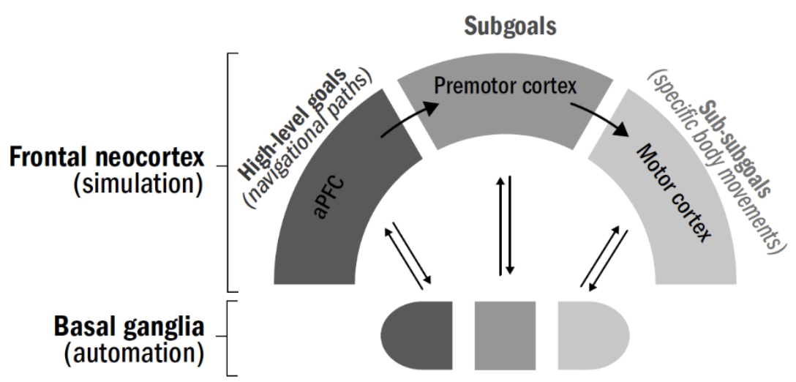
Memory and Simulation in the Brain
Basal Ganglia: Selecting Simulated Actions
The prefrontal cortex simulates actions before doing them.
It builds goals, plans, and counterfactuals.
Imagination becomes control.
Notes:
Earlier, we saw the basal ganglia as the brain’s reinforcement learning system—linking actions to rewards through dopamine signals.
But it does more than react to reward; it also evaluates imagined actions.
The basal ganglia receive potential plans from the prefrontal cortex and predicted outcomes from the hippocampus.
They use the same reward-learning mechanisms to rank these possibilities before any movement occurs.
In other words, the brain can run a mental version of trial and error—deciding what’s worth doing before doing it.
When dopamine neurons signal prediction error, they update the value of both real and simulated actions.
That’s how the system learns not just from experience, but from imagination.
The basal ganglia make simulation adaptive—they turn thought experiments into better decisions.
When we first met the basal ganglia, they learned from experience.
Here, we see evolution’s upgrade: using the same circuitry to learn from imagined experience instead.

Slide 16
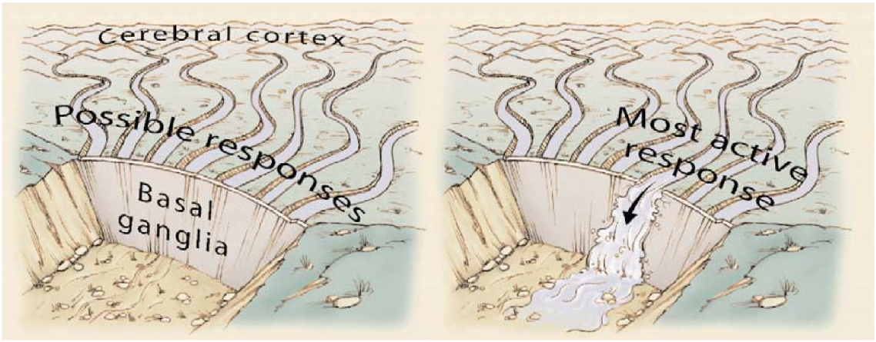
Memory and Simulation in the Brain
Integration: The Cortico–Hippocampal–Basal Ganglia Loop
Cortex predicts.
Hippocampus imagines.
Basal ganglia choose.
Together, they make thought actionable.
Notes:
Each system we’ve discussed plays a different role in the brain’s simulation loop.
The cortex builds predictive models of the world
—what’s likely to happen next.
The hippocampus uses those models to simulate past and future events,
generating new possibilities.
The basal ganglia evaluate those possibilities,
using dopamine signals to decide which imagined actions are worth pursuing.
These systems form a closed loop:
Cortex provides the model.
Hippocampus explores within it.
Basal ganglia select and reinforce the most promising plans.
Then the results feed back, updating the cortex and hippocampus in turn.
This coordination lets the brain move from raw prediction to imagination to decision
—turning mental simulation into adaptive behavior.
This is the integrated predictive architecture conserved across mammals
—a loop that links learning, memory, and action into one continuous cycle.

Slide 17
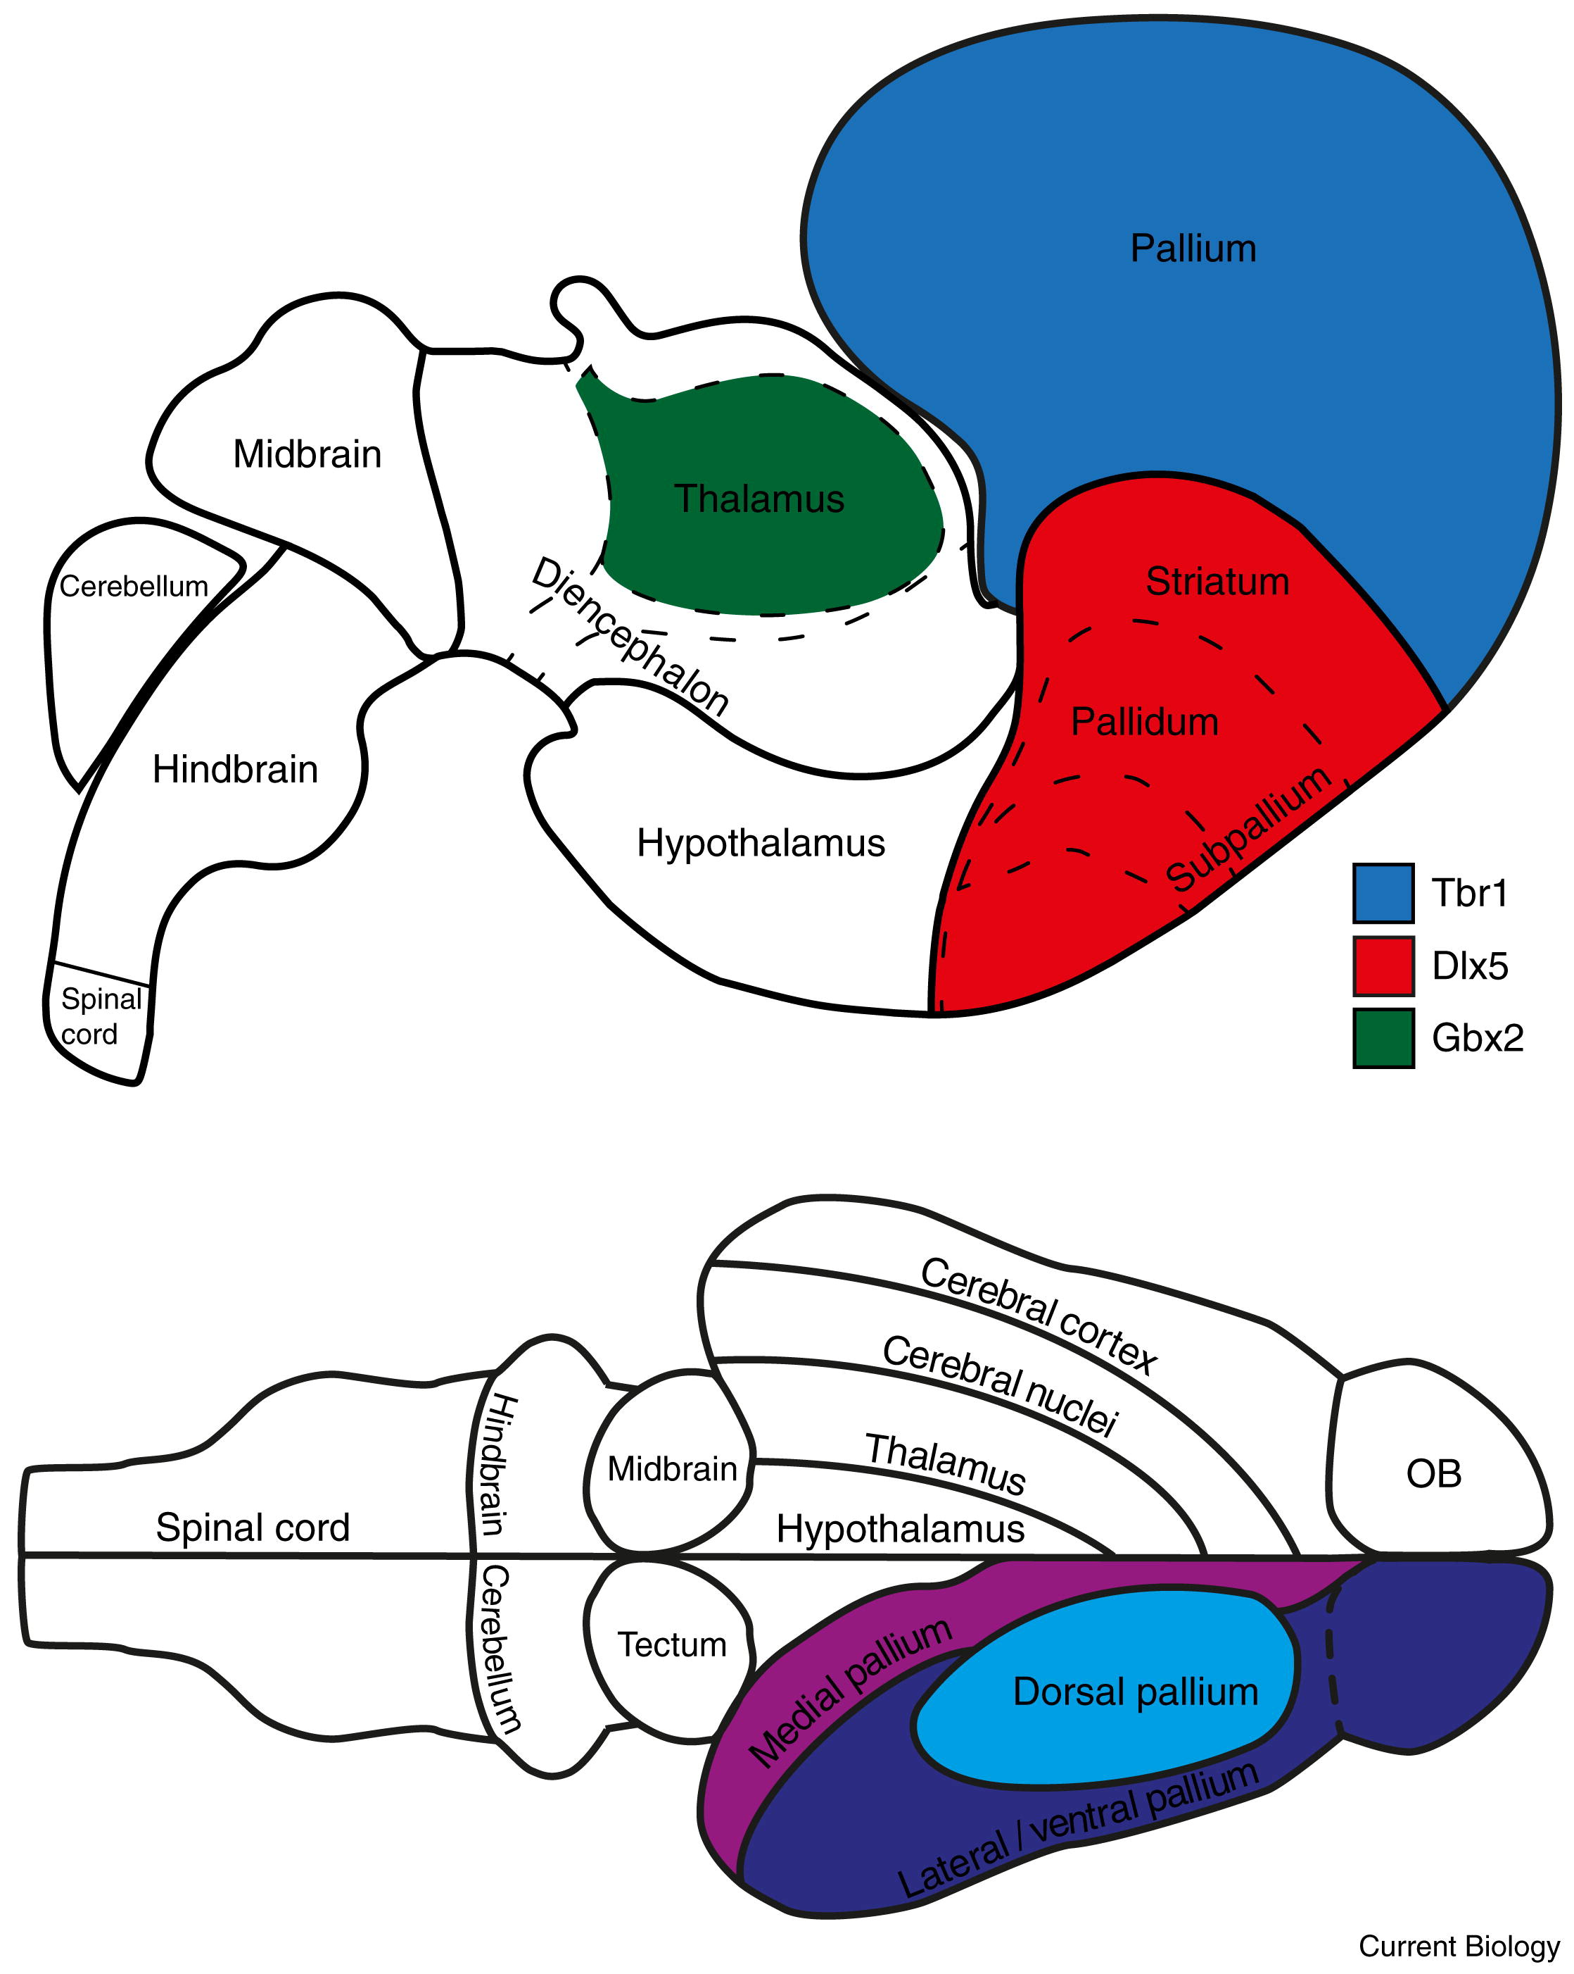
Memory and Simulation in the Brain
From Reptile Brain to Mammal Brain: Expanding the Predictive Circuit?
Mammals didn’t invent prediction.
They expanded it—adding memory, imagination, and control.
The neocortex scaled up an ancient loop.
Notes:
The fundamental predictive circuit—linking sensory input, motor output, and feedback—was already present in early vertebrates.
Reptiles could anticipate sensory consequences of movement and learn habits through reinforcement.
What changed in mammals wasn’t the algorithm, but its scale and complexity.
Evolution layered new cortical regions on top of older systems, expanding the predictive loop into a multi-level hierarchy.
The hippocampus added the ability to represent places and episodes;
the neocortex allowed abstraction and generalization;
and the prefrontal cortex introduced flexible planning and goal control.
In short, mammals took a fast, reactive prediction engine and turned it into a slow, reflective one—capable of simulating not just movements, but possible futures.

Slide 18
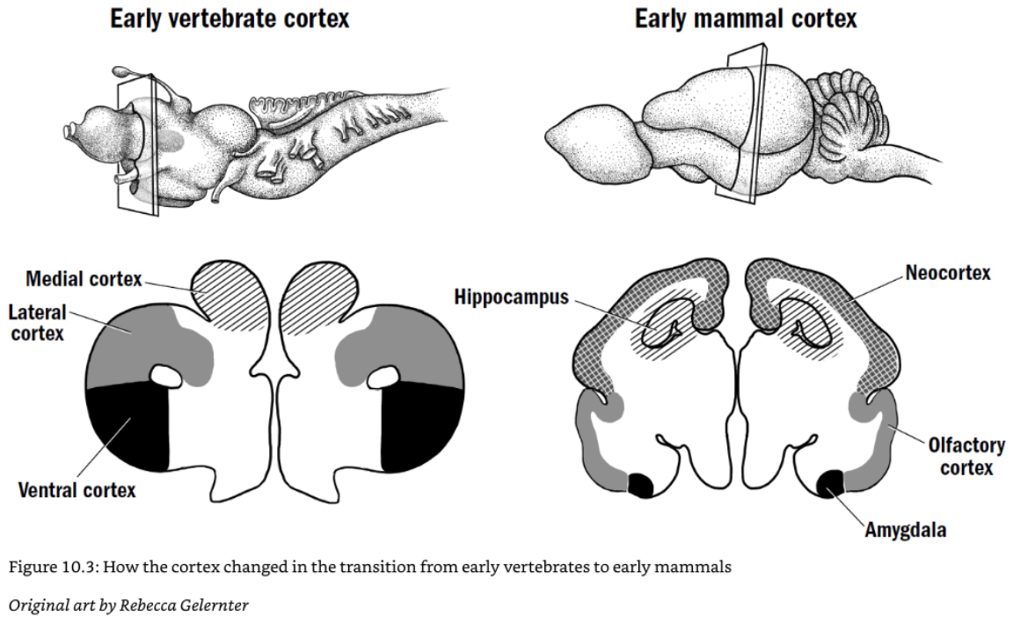
Memory and Simulation in the Brain
From Reptile Brain to Mammal Brain: Expanding the Predictive Circuit?
Mammals didn’t invent prediction.
They expanded it—adding memory, imagination, and control.
The neocortex scaled up an ancient loop.
Notes:
The fundamental predictive circuit—linking sensory input, motor output, and feedback
—was already present in early vertebrates.
Reptiles could anticipate sensory consequences of movement and learn habits through reinforcement.
What changed in mammals wasn’t the algorithm, but its scale and complexity.
Evolution layered new cortical regions on top of older systems,
expanding the predictive loop into a multi-level hierarchy.
The hippocampus added the ability to represent places and episodes;
the neocortex allowed abstraction and generalization;
and the prefrontal cortex introduced flexible planning and goal control.
In short, mammals took a fast, reactive prediction engine and turned it into a slow, reflective one
—capable of simulating not just movements, but possible futures.
The mammalian brain didn’t start fresh—it stretched and recycled ancient predictive machinery.
Evolution’s trick was adding layers of imagination on top of instinct.

Slide 19
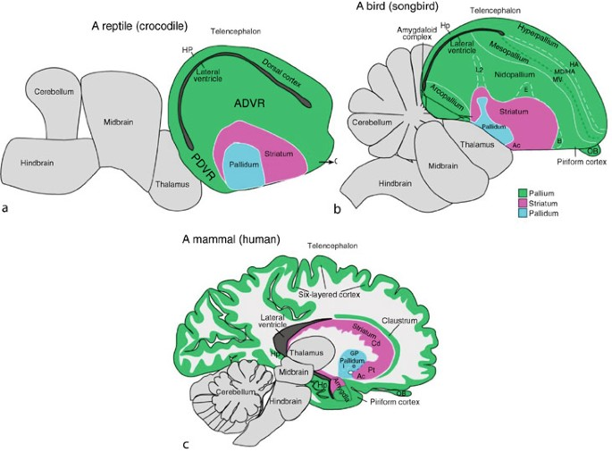
Memory and Simulation in the Brain
Birds and Convergent Circuits: Parallel Solutions to Prediction
Birds lack a neocortex—but not imagination.
The avian pallium evolved its own predictive circuits.
Different anatomy, same computation.
Notes:
Mammals aren’t the only lineage that mastered prediction and simulation.
Birds, especially corvids and parrots, evolved comparable abilities
—planning, tool use, even episodic-like memory—without a six-layer cortex.
Instead, their pallium—a differently organized but homologous structure
—implements similar loops of feedforward and feedback signaling.
Neurons in the avian pallium show predictive coding, mismatch responses,
and replay-like activity, just as in mammalian cortex and hippocampus.
This is a case of convergent evolution:
two separate neural architectures discovering the same computational principle.
What matters isn’t cortical layering—it’s the circuit logic of prediction, comparison, and update.
Evolution found multiple ways to build a brain that imagines.
Prediction isn’t tied to a particular brain shape—it’s an organizing logic.
The same loop that mammals built in six layers,
birds built in clusters—and both can imagine.

Slide 20
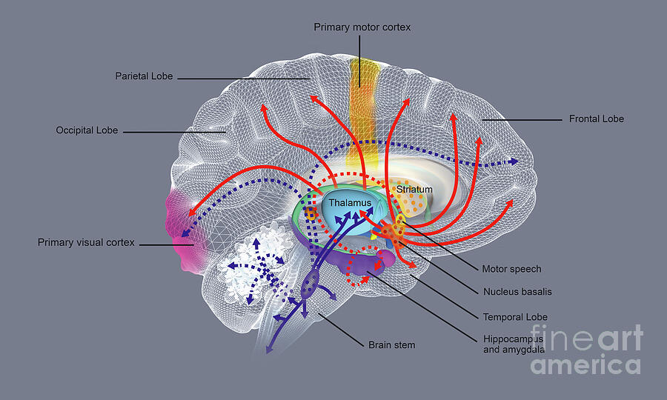
Memory and Simulation in the Brain
Dreaming and Predictive Maintenance
Dreaming recalibrates the generative model.
REM sleep replays, recombines, and repairs predictions.
The brain updates itself offline.
Notes:
During REM sleep, the brain enters a state of intense internal activity.
Sensory input is mostly shut off, yet cortical and hippocampal circuits remain highly active—replaying and recombining memories.
This replay isn’t random.
It helps the brain recalibrate its predictive model:
testing connections, strengthening useful ones, and pruning those that no longer fit.
Dreams are the phenomenological side of this process—what it feels like when the brain runs its generative network with no external constraints.
The same structures involved in perception and imagination—hippocampus, cortex, and limbic circuits—activate during dreams.
Evolution may have preserved REM sleep as a kind of predictive maintenance cycle, letting the model stay stable, flexible, and ready for novelty.
Dreaming keeps the model in tune.

Slide 21
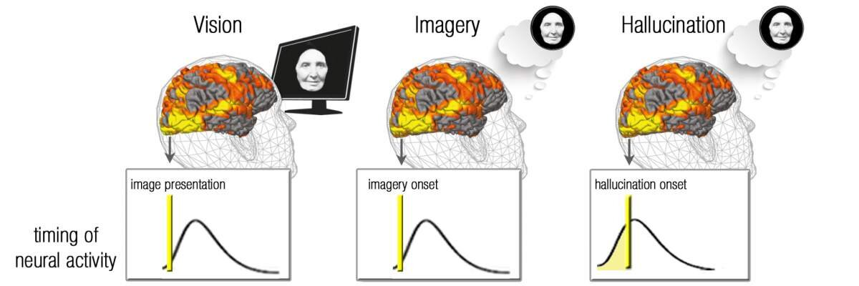
Memory and Simulation in the Brain
When Prediction Fails: Hallucination, Delusion, and Sensory Overload
Too much prediction → hallucination.
Too much input → chaos.
Perception depends on balance.
Notes:
Perception works only when prediction and input stay in balance.
When predictions dominate, the brain imposes its own expectations on reality—producing hallucinations or delusions.
When input dominates, as in sensory overload or certain psychiatric states, the world becomes fragmented and overwhelming.
In psychosis, the brain’s higher-level models often fail to update properly, causing mismatches to be interpreted as meaningful signals rather than noise.
In extreme sensory deprivation, the opposite happens: with no data to constrain it, the brain’s generative model free-runs, creating vivid imagery and voices.
These breakdowns reveal what perception really is: a controlled hallucination stabilized by evidence.
When that control weakens—whether through loss of input or faulty prediction—the brain’s model drifts away from reality.
The same loop that gives us perception can, when mis-tuned, create hallucination.
These failures don’t show a different system—they show the predictive system pushed out of equilibrium.

Slide 22
Memory and Simulation in the Brain
Energy and Efficiency:
The Cost of Prediction
Prediction saves energy—
but maintaining the model is expensive.
Brains trade computation for surprise reduction.
Other
Brain
Skeletal
Muscles
Heart
Kidneys
Liver & Spleen
Notes:
Prediction evolved partly because it’s efficient.
It’s cheaper to anticipate than to react.
By predicting incoming input, the brain can filter out redundancy and focus on what’s unexpected—saving energy and time.
But building and maintaining a high-fidelity predictive model is itself costly.
The brain consumes about 20% of the body’s energy, even at rest.
Much of that energy supports the constant neural chatter of updating, testing, and synchronizing predictions.
Evolution optimized not for minimal activity, but for minimal surprise.
Brains invest energy up front so that behavior can be fast and adaptive later.
It’s a biological tradeoff: spend power to save time.
Prediction looks efficient only from the outside.
Inside, it’s an energy-intensive strategy—an evolutionary bet that thinking ahead costs less than being surprised.

Slide 23
Memory and Simulation in the Brain
Summary
Prediction is the brain’s core computation.
Memory and imagination are its extensions.
Next Time
Social Cognition: How minds learned to model each other.
Notes:
Across this lecture, we’ve seen how prediction isn’t just a strategy—it’s the organizing principle of the brain.
The cortex, hippocampus, and basal ganglia form a continuous loop that predicts, imagines, and evaluates—turning raw sensation into thought and action.
The cortex models the sensory world.
The hippocampus simulates possible situations.
The basal ganglia use reward signals to choose among them.
Together, they create a brain that can run internal models of the world before acting in it.
But once this predictive machinery evolved, it found a new and powerful use:
modeling other beings.
The same circuits that let mammals imagine their own future actions could now simulate the goals, beliefs, and emotions of others—forming the basis of social cognition.
Next week, we’ll follow that transition—from solitary simulation to social imagination—examining how primates evolved the ability to predict not just the world, but each other.
The predictive brain began as a tool for survival—modeling the physical world.
In primates, it became something new: a window into the social world.
Next week, we’ll explore how that transformation gave rise to empathy, cooperation, and the roots of mindreading.
pm.

